Slide 1
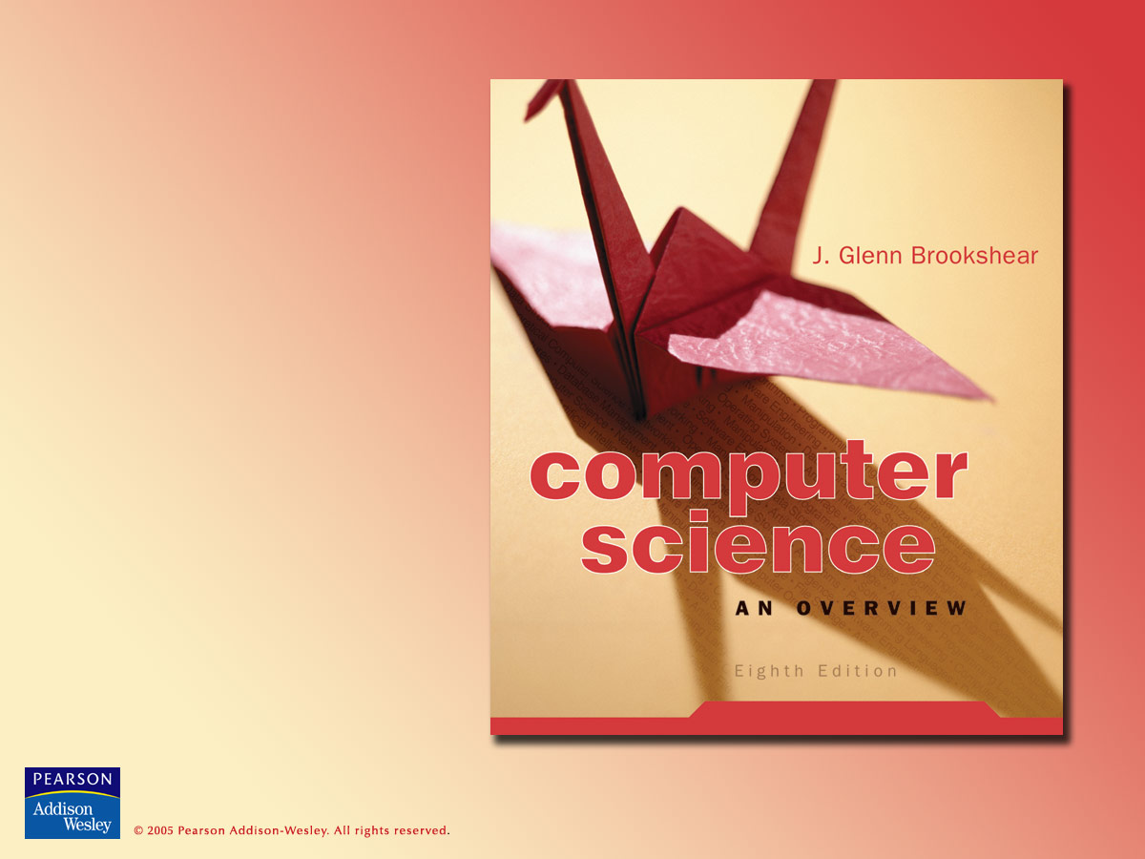
Chapter 4
Networking and
the Internet

Slide 2

Chapter 4: Networking and the Internet
4.1 Network Fundamentals
4.2 The Internet
4.3 The World Wide Web
4.4 Network Protocols
4.5 Security

Slide 3
Network classifications
Local area network (LAN)
Wide area network (WAN)
Closed, or proprietary
Open

Slide 4
Network topologies
Ring
Bus
Star
Irregular

Slide 5
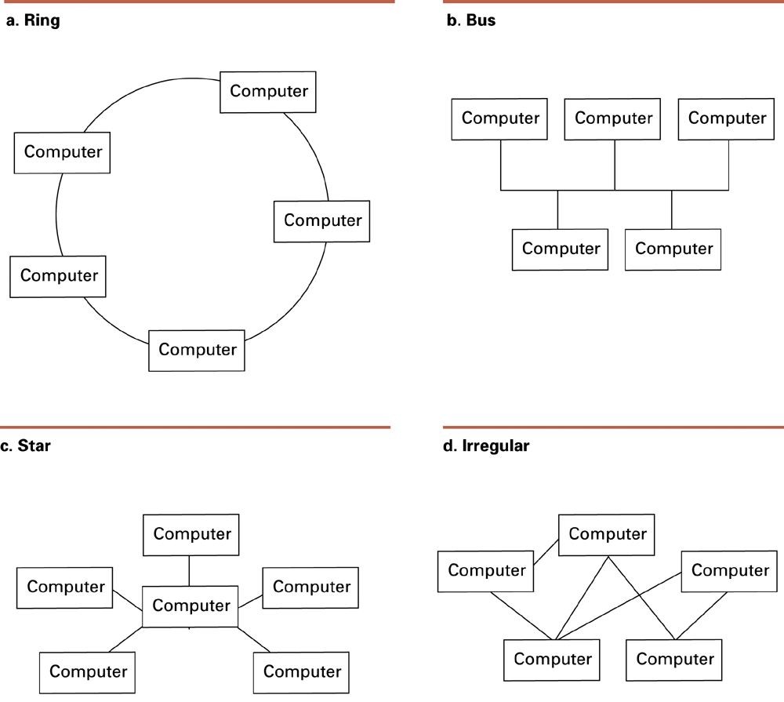
Figure 4.1 Network topologies

Slide 6
Figure 4.1 Network topologies (cont’d)

Slide 7
Connecting networks
Bridge: connects two compatible networks
Router: connects two incompatible networks
  Resulting “network” is called an internet

Slide 8
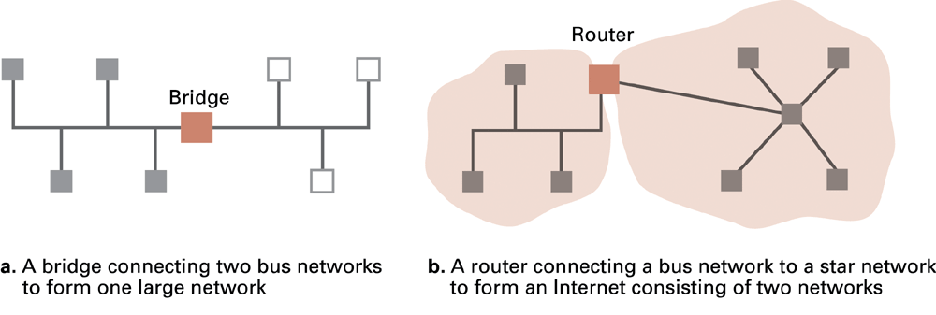
Figure 4.2 The distinction between a bridge and a router

Slide 9
Inter-process communication
Client-server
  One server, many clients
  Server must execute continuously
  Client initiates communication
Peer-to-peer
  Two processes communicating as equals
  Peer processes can be short-lived

Slide 10
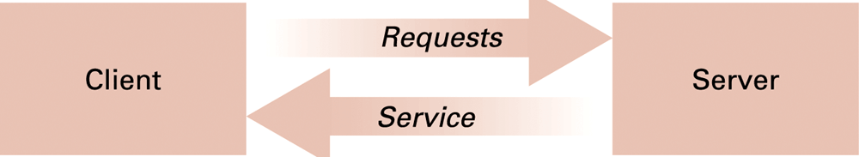
Figure 4.3 The client/ server model

Slide 11
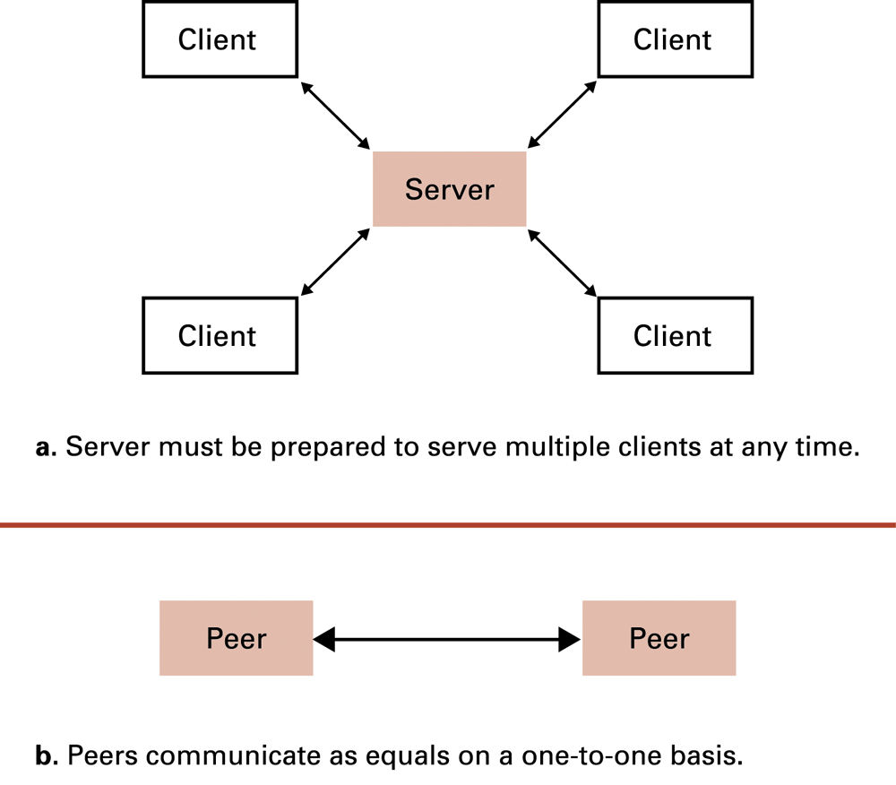
Figure 4.4 The client/server model compared to the peer-to-peer-model

Slide 12
Distributed systems
Systems with parts that run on different computers
  Infrastructure usually provided by standardized toolkits
    Example: Enterprise Java Beans from Sun Microsystems
    Example: .NET framework from Microsoft

Slide 13
The Internet
The Internet: one internet spanning the world
  Started by DARPA in 1973
  Today involves millions of machines

Slide 14
Internet Architecture
Domain = network or internet controlled by one organization
Gateway = router connecting a domain to the cloud
  cloud = the rest of the internet
Domains must be registered by their owners
  Internet Corporation for Assigned Names & Numbers (ICANN) serves as registrar

Slide 15
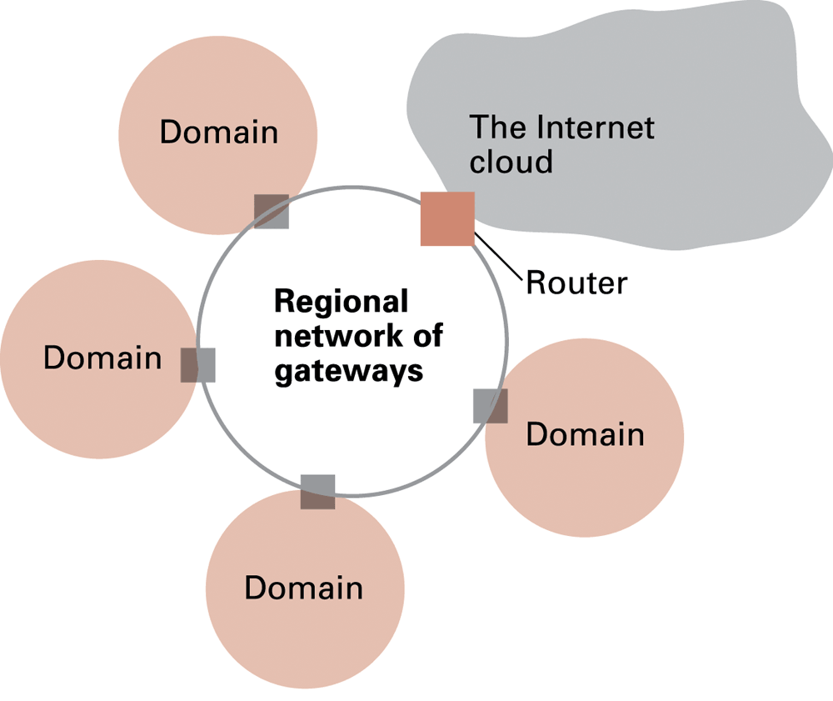
Figure 4.5 A typical approach to connecting to the Internet

Slide 16
Strategies for connecting to the Internet
Large organization: buy a direct connection
Small organization or individual: link domain to the domain of an ISP
  ISP = Internet Service Provider
Individual: temporarily link computer into ISP’s domain

Slide 17
Internet Addressing: IP Addresses
IP address = 32 bit identifier for a machine
  Network identifier = part assigned by ICANN
  Host address = part assigned by domain owner
Dotted decimal notation = standard for displaying IP addresses
  Example: 192.207.177.133

Slide 18
Internet addressing: host names
Host name = mnemonic name
  Example: mymachine.aw.com
  Domain name = part assigned by a registrar
    Example: aw.com
    Top level domain = classification of domain owner
      By usage – Example: .com = commercial
      By country – Example: .au = Australia
  Subdomains and individual machine names
    Assigned by domain owner
    Domain owner must run a name server
      .

Slide 19
Internet applications
Electronic main (e-mail)
File Transfer Protocol (FTP)
Remote login: telnet, etc.
World Wide Web

Slide 20
Electronic mail
Mail server: set up by domain owner
  Mail sent from domain members goes through mail server
  Mail sent to domain members is collected by mail server
  Mail delivered to clients on demand
    POP3
    IMAP

Slide 21
World Wide Web
Server disseminates hypertext (or hypermedia) documents
  Web site = all hypertext documents controlled by one organization or individual
    Usually all at same internet address
  HTML = language of hypertext documents
  Other content can also be disseminated
    Example: images

Slide 22
World Wide Web implementation
Web server: provides access to documents on its machine as requested
Browser: allows user to access web pages
Hypertext Transfer Protocol (HTTP): communication protocol used by browsers and web servers
Uniform Resource Locator (URL): unique address of a document on the web

Slide 23
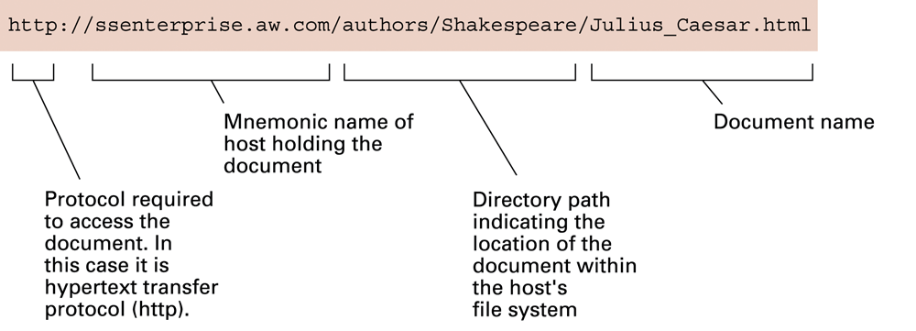
Figure 4.6 A typical URL

Slide 24
Hypertext document format
Entire document is printable characters
Contains tags to control display
  Display appearance
  Links to other documents and content
  Dynamic functions

Slide 25
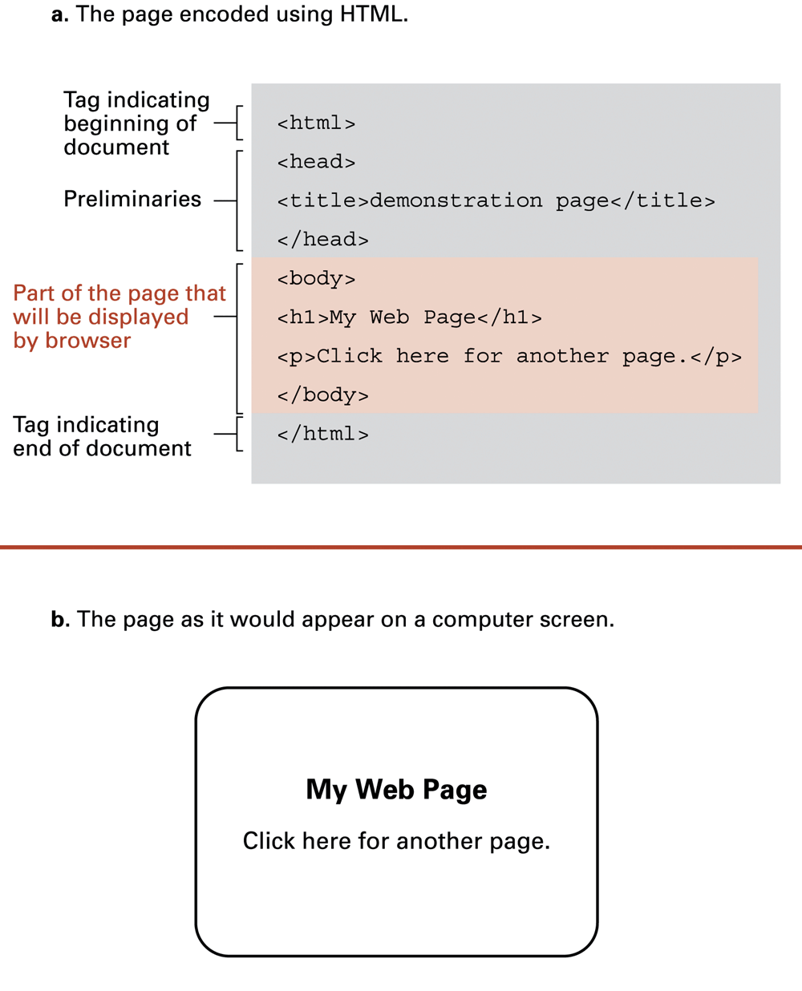
Figure 4.7 A simple Web page

Slide 26
Figure 4.7 A simple Web page (cont’d)

Slide 27
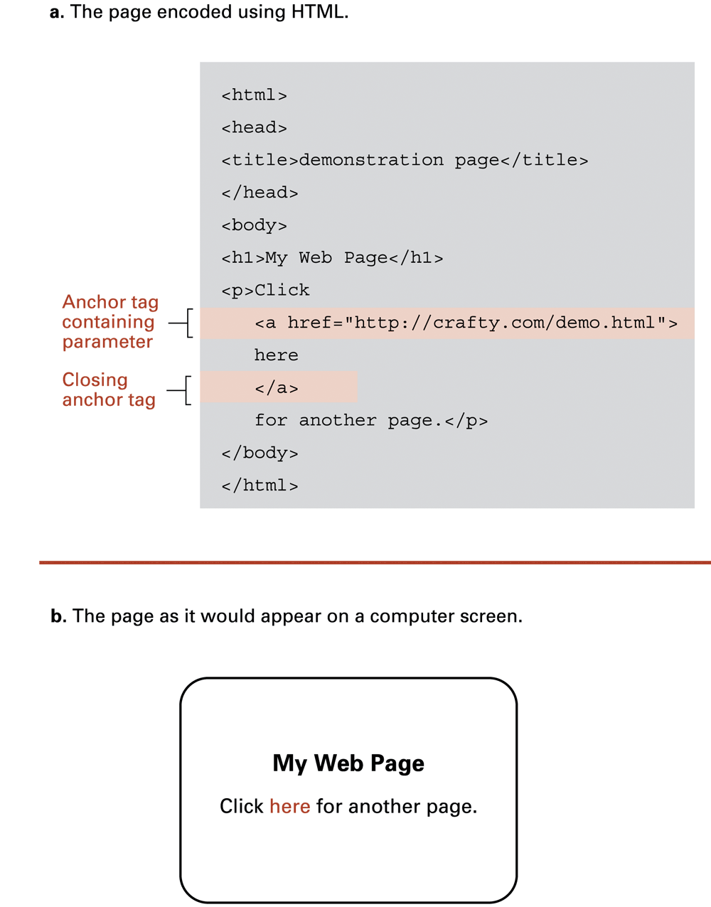
Figure 4.8 An enhanced simple Web page

Slide 28
Figure 4.8 An enhanced simple Web page (cont’d)

Slide 29
Extensible Markup Language (XML)
XML: a language for constructing markup languages similar to HTML
  A descendant of SGML

Slide 30
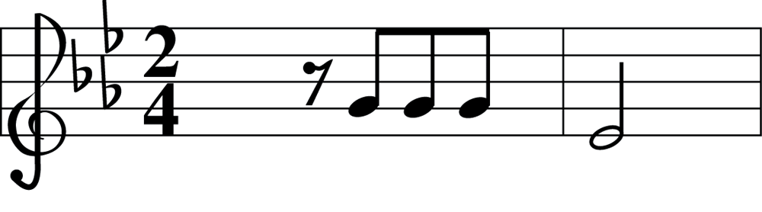
Figure 4.9 The first two bars of Beethoven’s Fifth Symphony

Slide 31
Dynamic web pages
Client-side
  Examples: java applets, javascript, Macromedia Flash
Server-side
  Common Gateway Interface (CGI)
  Servlets
  PHP

Slide 32
Network protocols: transmission control
Token ring: one-way communication around ring network
Ethernet:
  Uses carrier sense, multiple access with collision detection (CSMA/CD)
  Popular for bus networks
  Like a conversation in small group

Slide 33
Internet software layers
Application layer:
  Example: browser
Transport layer: TCP/IP, UDP
Network layer: handles routing through the internet
Link layer: handles actual transmission of packets
  Token ring or Ethernet

Slide 34
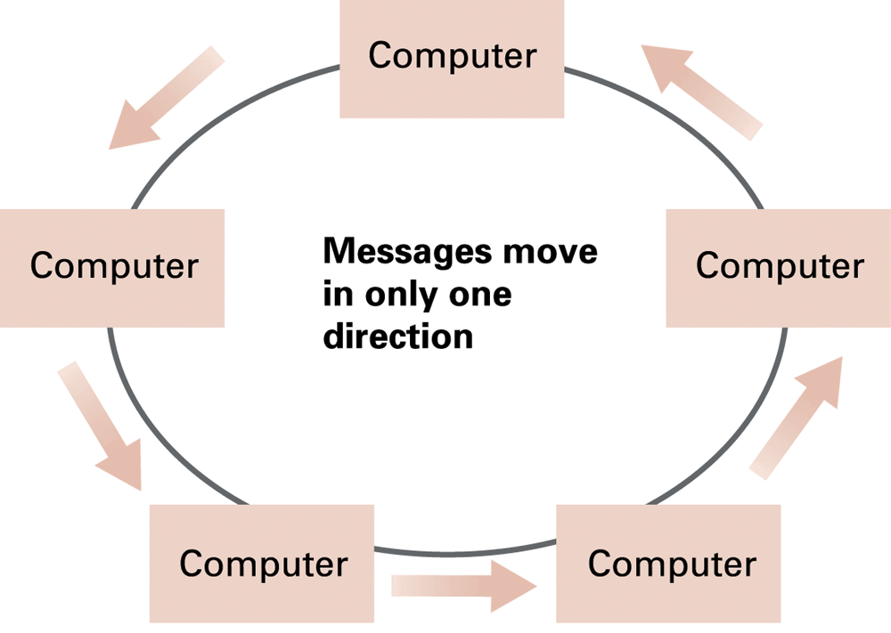
Figure 4.10 Communication over a ring network

Slide 35
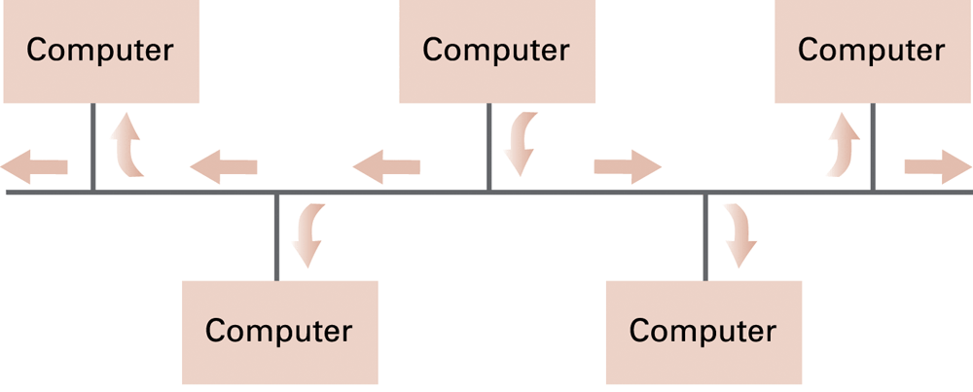
Figure 4.11 Communication over a bus network

Slide 36
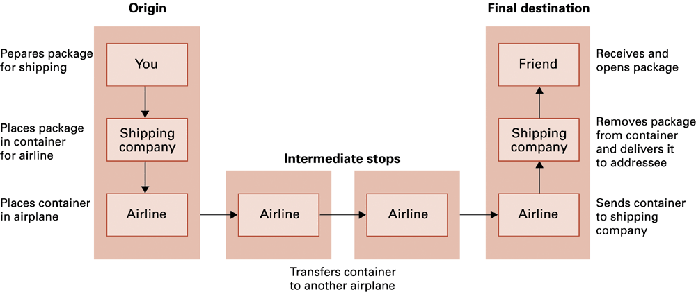
Figure 4.12 Package-shipping example

Slide 37
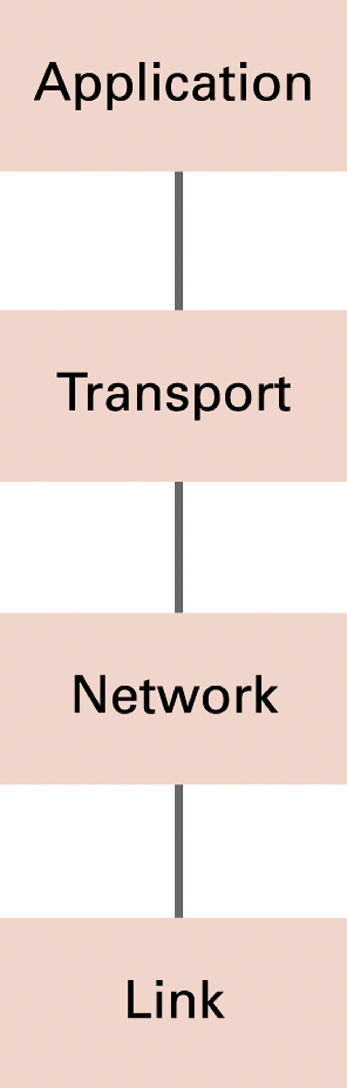
Figure 4.13 The Internet software layers

Slide 38
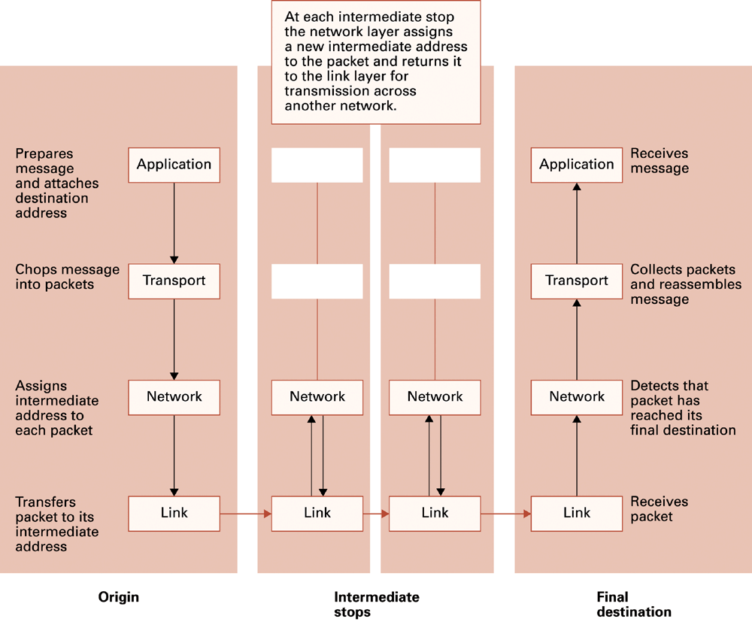
Figure 4.14 Following a message through the Internet

Slide 39
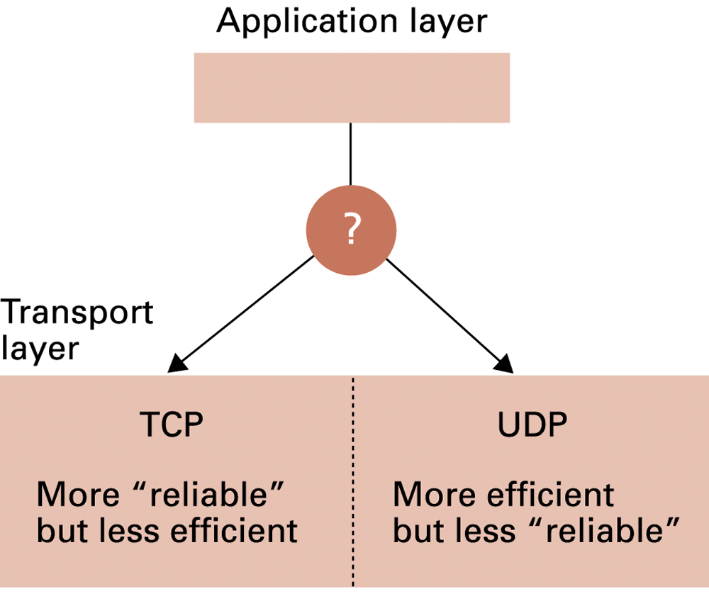
Figure 4.15 Choosing between TCP and UDP

Slide 40
Network security
Privacy of communication
  Public-key encryption
Integrity of machine exposed to internet
  Attacks: viruses and worms
  Defense: firewall

